Slide 1
WELCOME.....

Slide 2
SQL REINFORCEMENT PROJECT
NAME:LOGESH
DATE:21/01/2025
COURSE:DA&DS

Slide 3
OVERVIEW OF SQL:
SQL (Structured Query Language) is a standardized programming language used for managing and manipulating relational databases. It enables users to interact with databases to perform various operations such as:
DATA RETRIEVEL
DATA MANIPULATION
DATA CONTROL
TRANSACTION CONTROL

Slide 4
TABLES INCLUDED IN IMDB:
MOVIES
GENRE
DIRECTOR MAPPING
ROLE MAPPING
NAMES
RATINGS

Slide 5
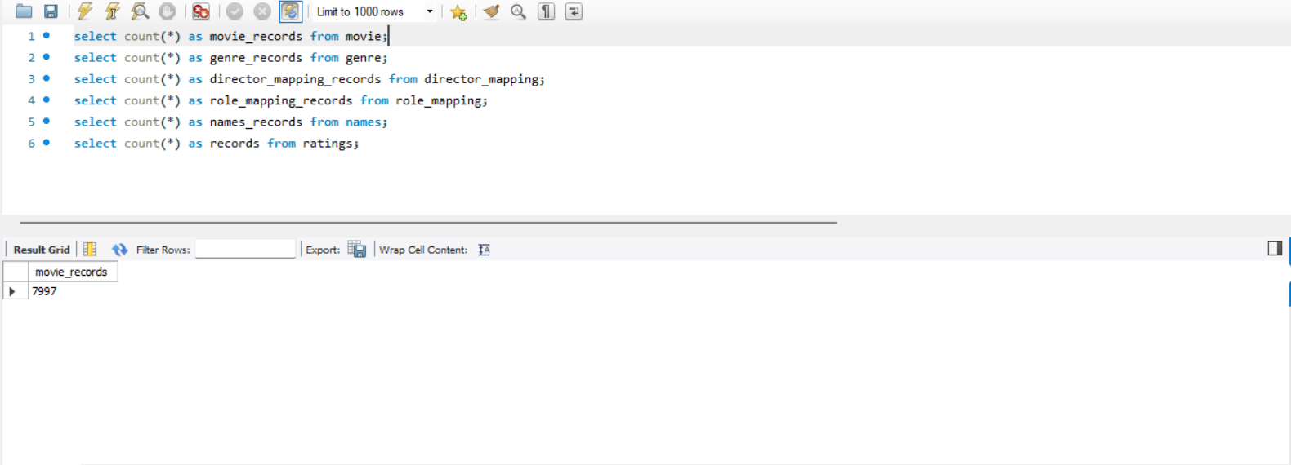
1. Count the total number of records in each table of the database.

Slide 6
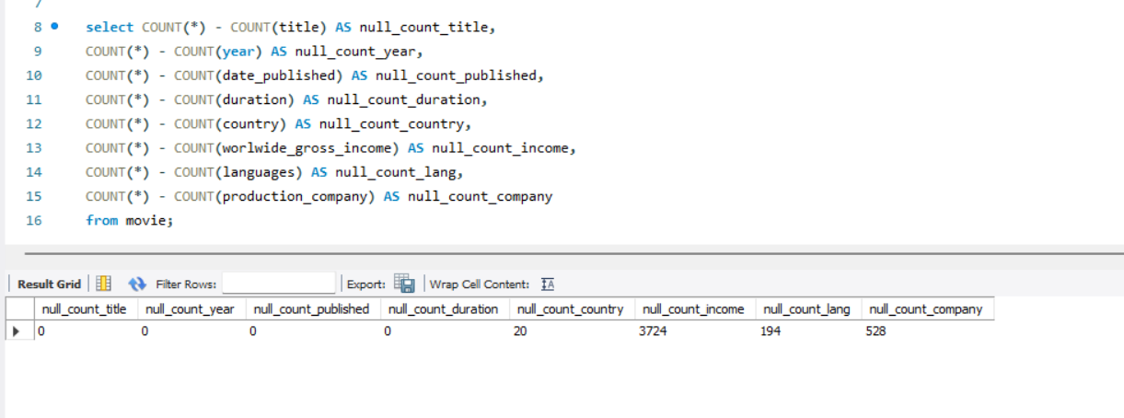
2. Identify which columns in the movie table contain null values.

Slide 7
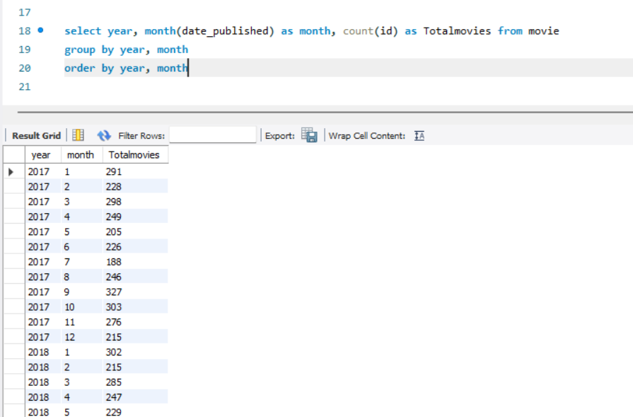
3. Determine the total number of movies released each year, and analyze how the trend changes month-wise.

Slide 8
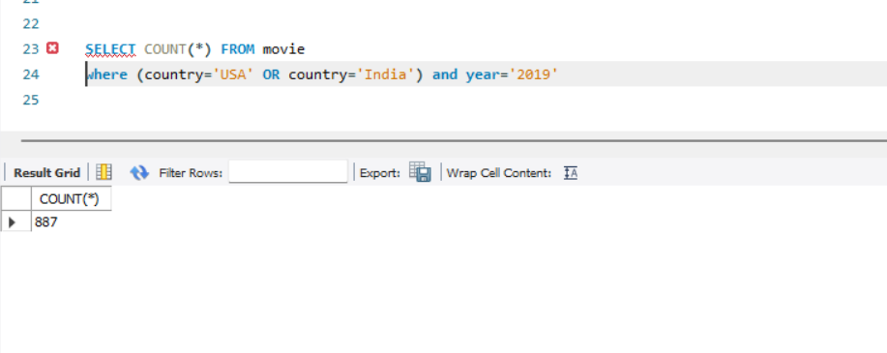
4. How many movies were produced in either the USA or India in the year 2019?

Slide 9
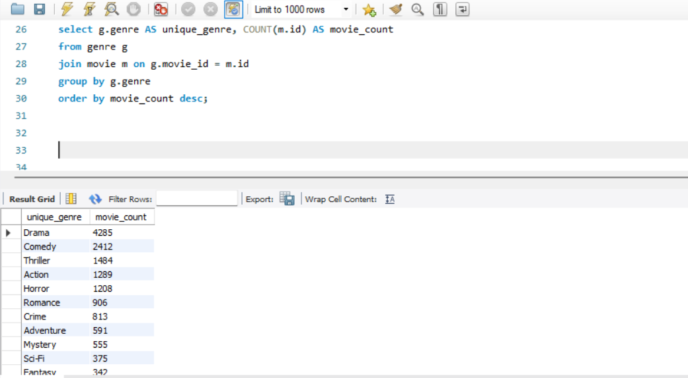
5. List the unique genres in the dataset, and count how many movies belong exclusively to one genre.

Slide 10
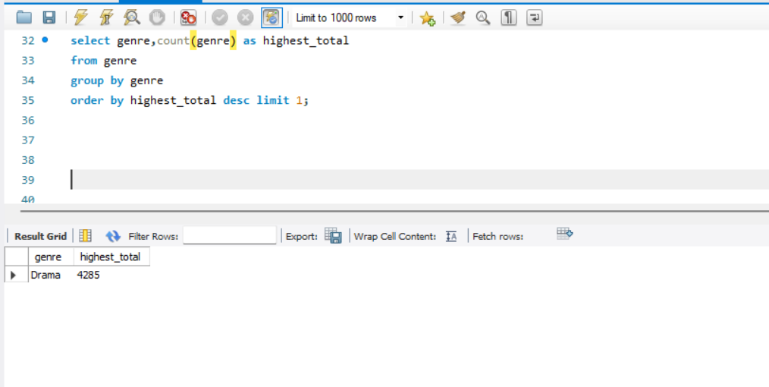
6. Which genre has the highest total number of movies produced?

Slide 11
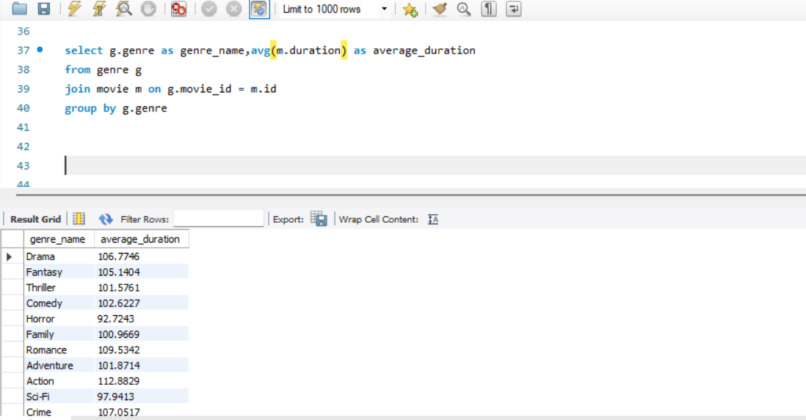
7. Calculate the average movie duration for each genre.

Slide 12
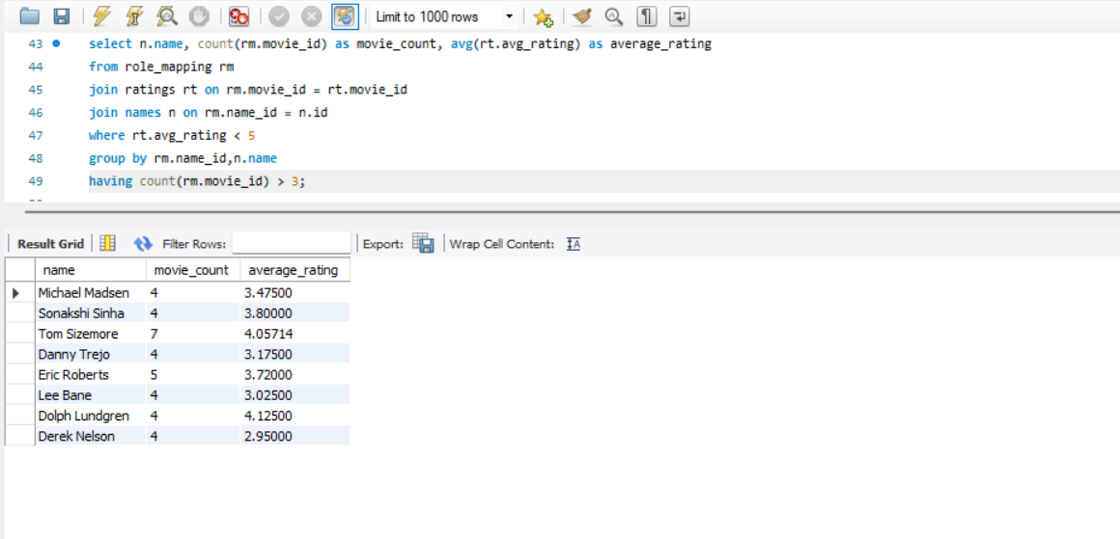
8. Identify actors or actresses who have appeared in more than three movies with an average rating below 5.

Slide 13
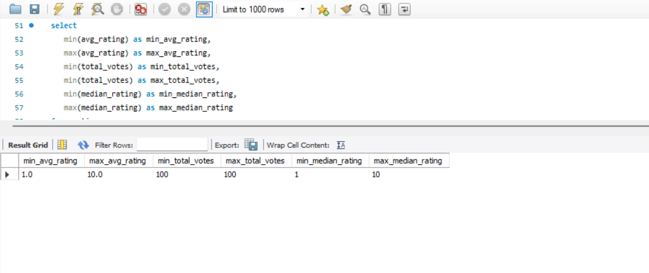
9. Find the minimum and maximum values for each column in the ratings table, excluding the movie_id column.

Slide 14
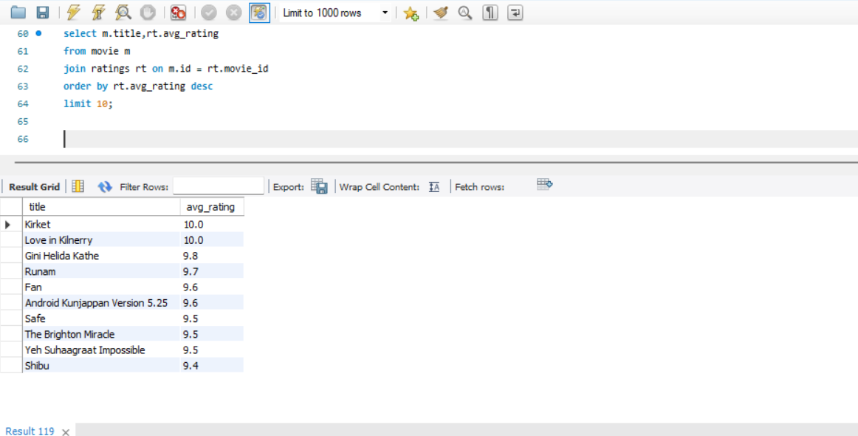
10. Which are the top 10 movies based on their average rating?

Slide 15
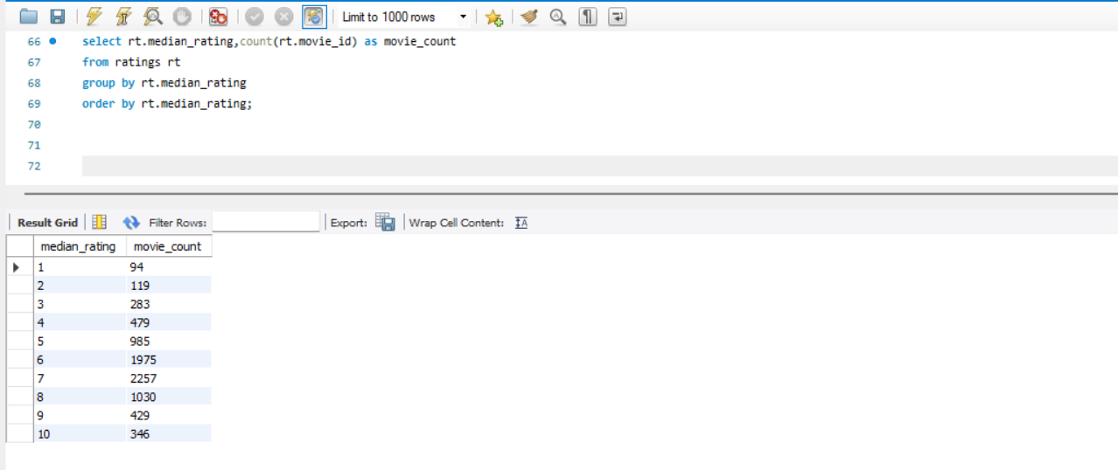
11. Summarize the ratings table by grouping movies based on their median ratings

Slide 16
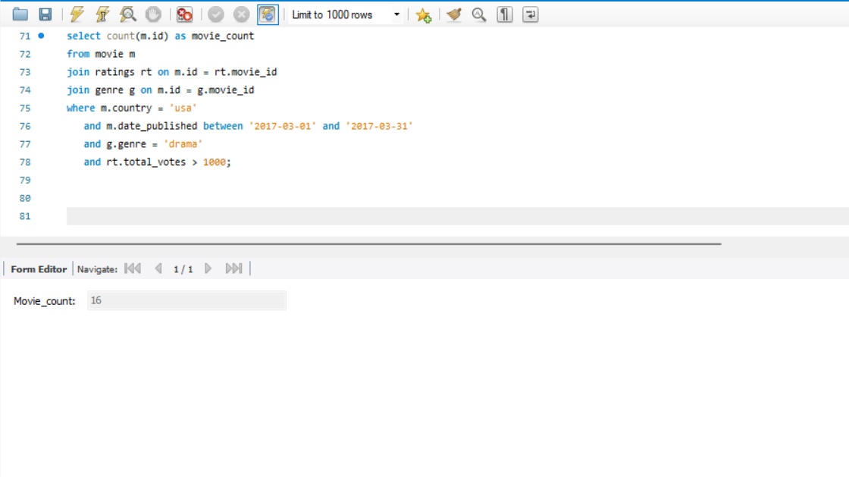
12. How many movies, released in March 2017 in the USA within a specific genre, had more than 1,000 votes?

Slide 17
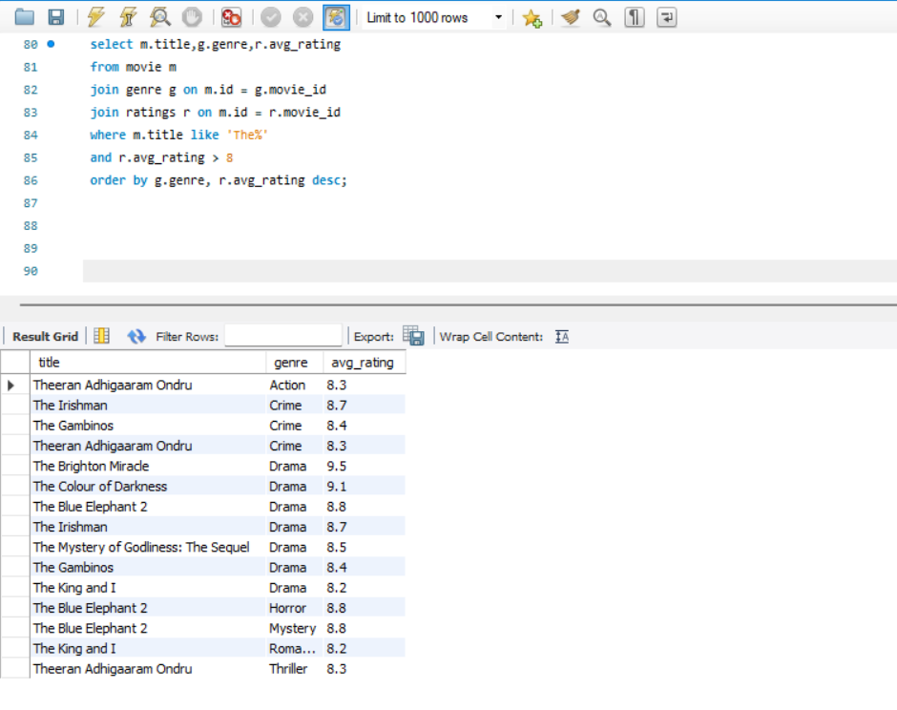
13. Find movies from each genre that begin with the word “The” and have an average rating greater than 8.

Slide 18
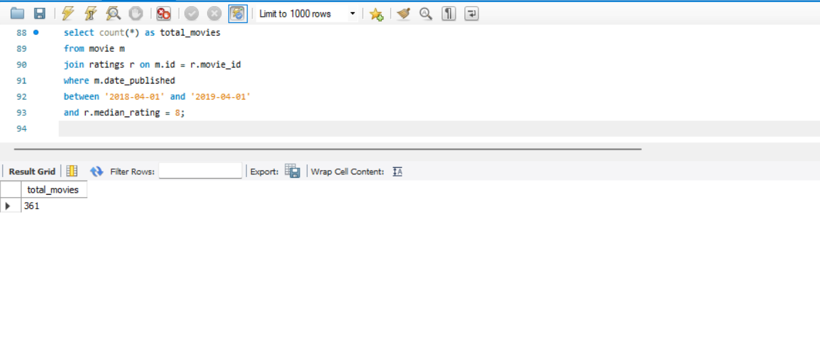
14. Of the movies released between April 1, 2018, and April 1, 2019, how many received a median rating of 8?

Slide 19
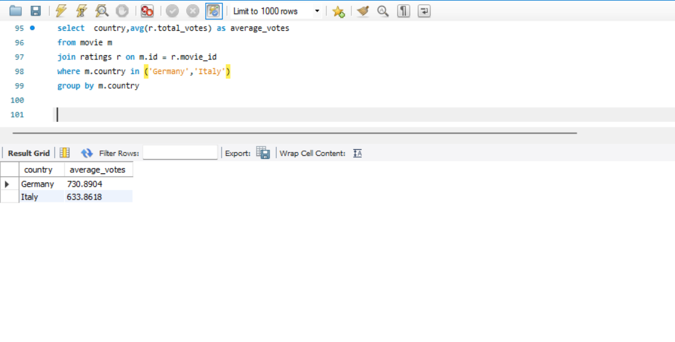
15. Do German movies receive more votes on average than Italian movies?

Slide 20
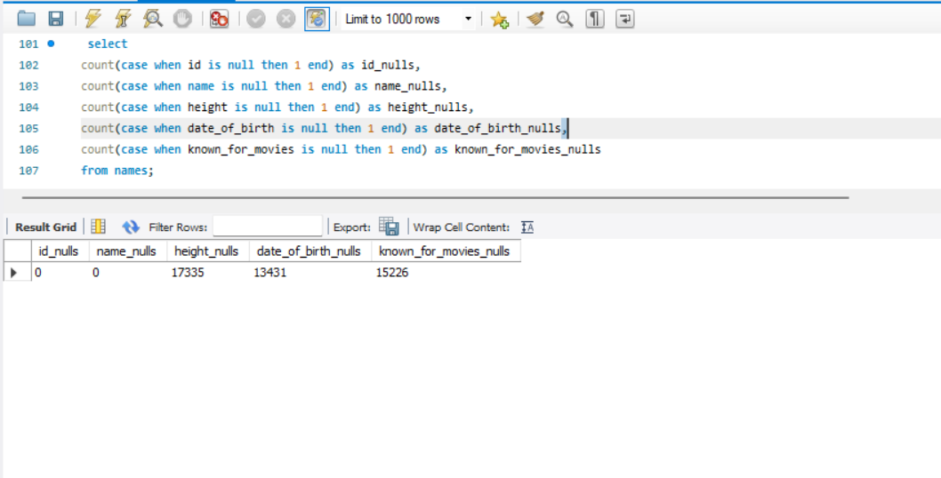
16. Identify the columns in the names table that contain null values.

Slide 21
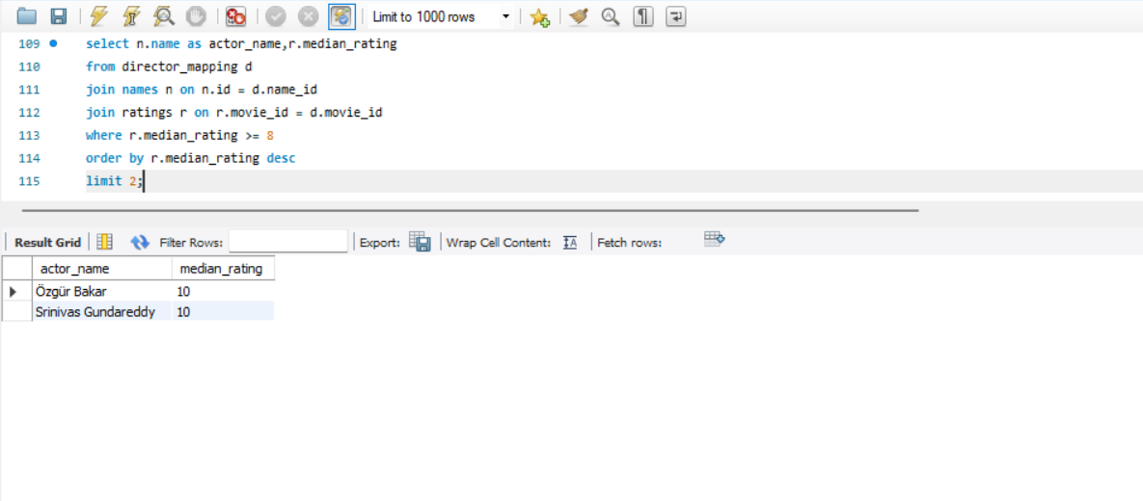
17. Who are the top two actors whose movies have a median rating of 8 or higher?

Slide 22
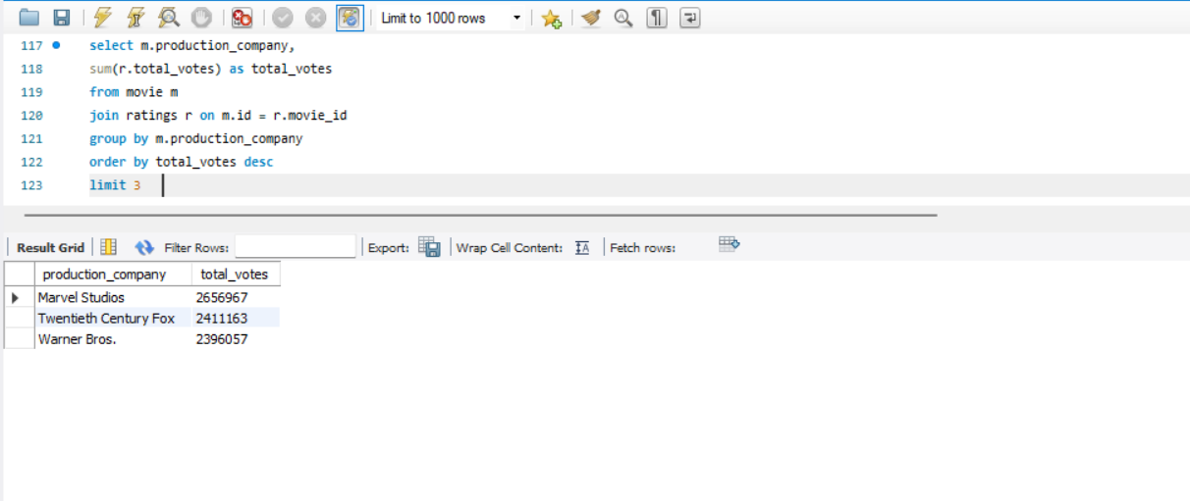
18. Which are the top three production companies based on the total number of votes their movies received?

Slide 23
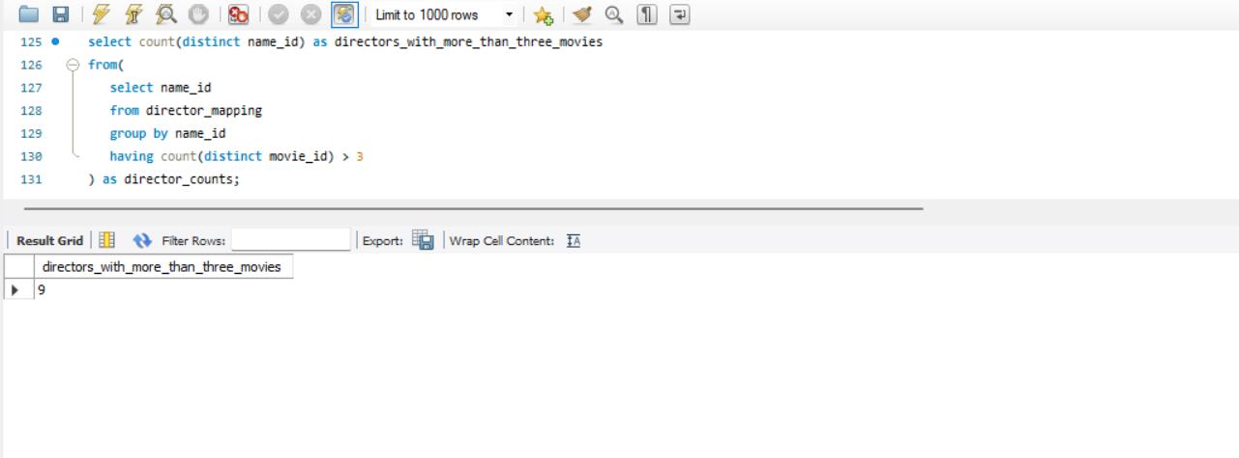
19. How many directors have worked on more than three movies?

Slide 24
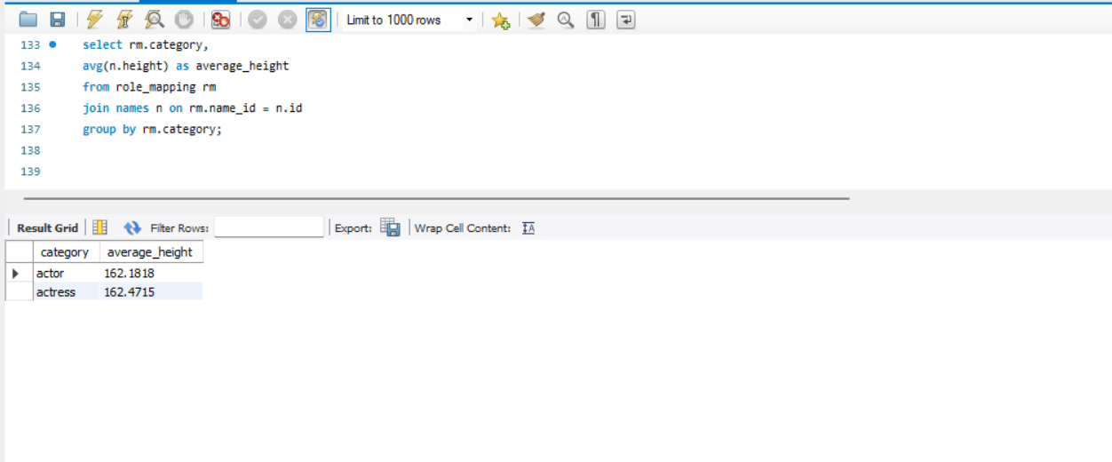
20. Calculate the average height of actors and actresses separately.

Slide 25
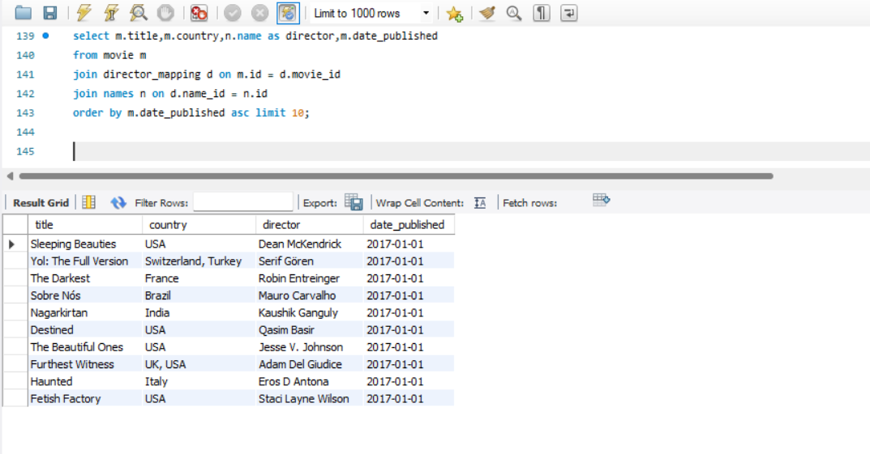
21. List the 10 oldest movies in the dataset along with their title, country, and director.

Slide 26
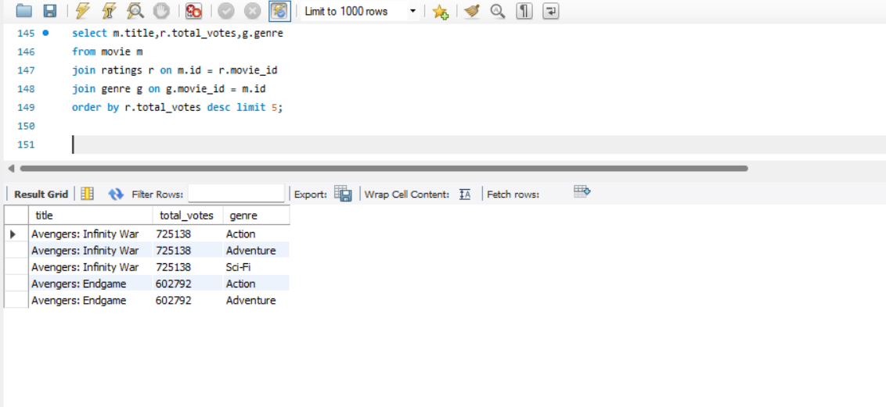
22. List the top 5 movies with the highest total votes, along with their genres.

Slide 27
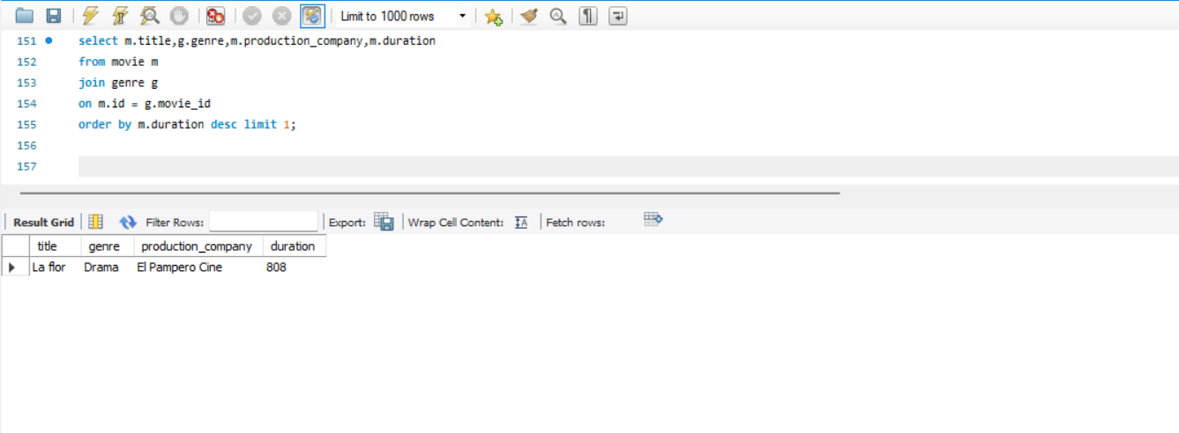
23. Identify the movie with the longest duration, along with its genre and production company.

Slide 28
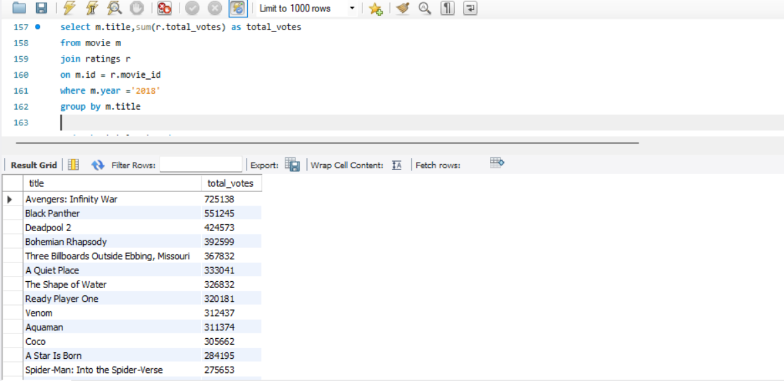
24. Determine the total number of votes for each movie released in 2018.

Slide 29
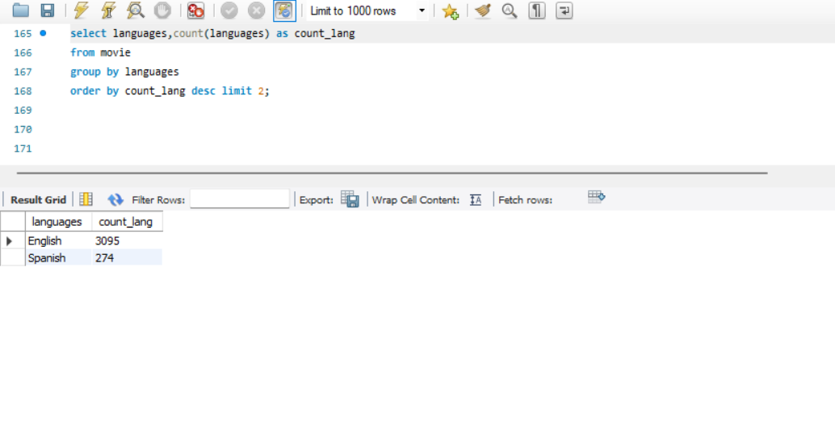
25. What is the most common language in which movies were produced?

Slide 30
CONCLUSION:
BETTER UNDERSTANDING OF THE DATA IN THE COMPLEX DATA
MEANING PATTERNS IN THE MOVIES PRODUCTION
ANALYZED THE DATA OF THE ACTOR/ACTRESS IN THE MOVIES PRODUCTION

Slide 31
THANK YOU....

